Slide 1




4
Functions in Excel
Prepared By :
Said Fawzy
Manager of Information Center
Tendering Department
Arab Contractors

Slide 2

1
What is a function ?
2
Function Elements
3
Using The Insert Function
4
The Autosum shortcut

Slide 3
1
What is Function?

Slide 4


Slide 5
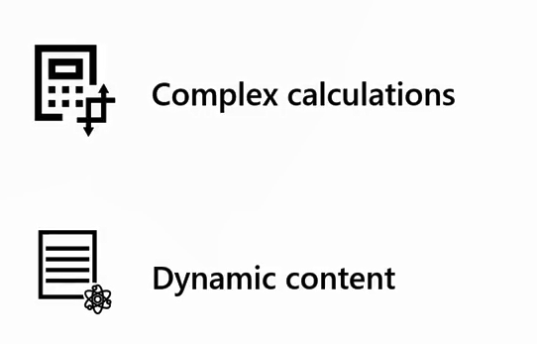
Functions are useful

Slide 6
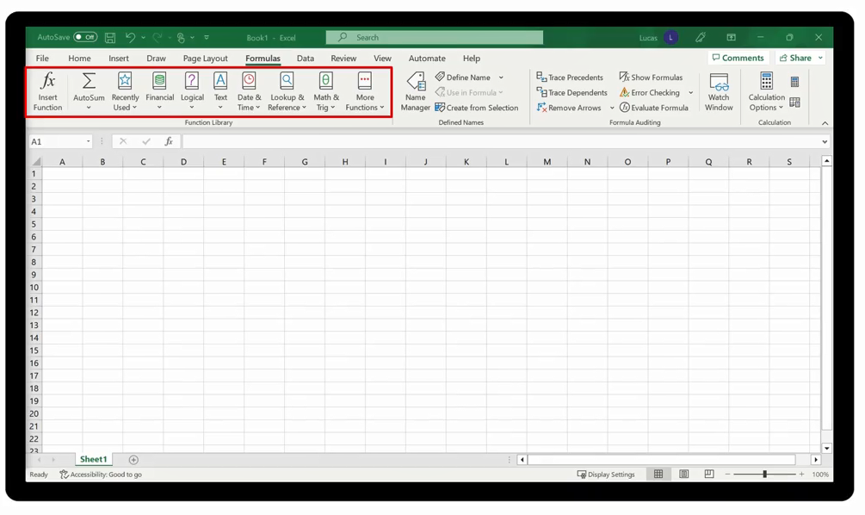
Excel contains many built-in functions

Slide 7
2
Function Elements

Slide 8


Slide 9
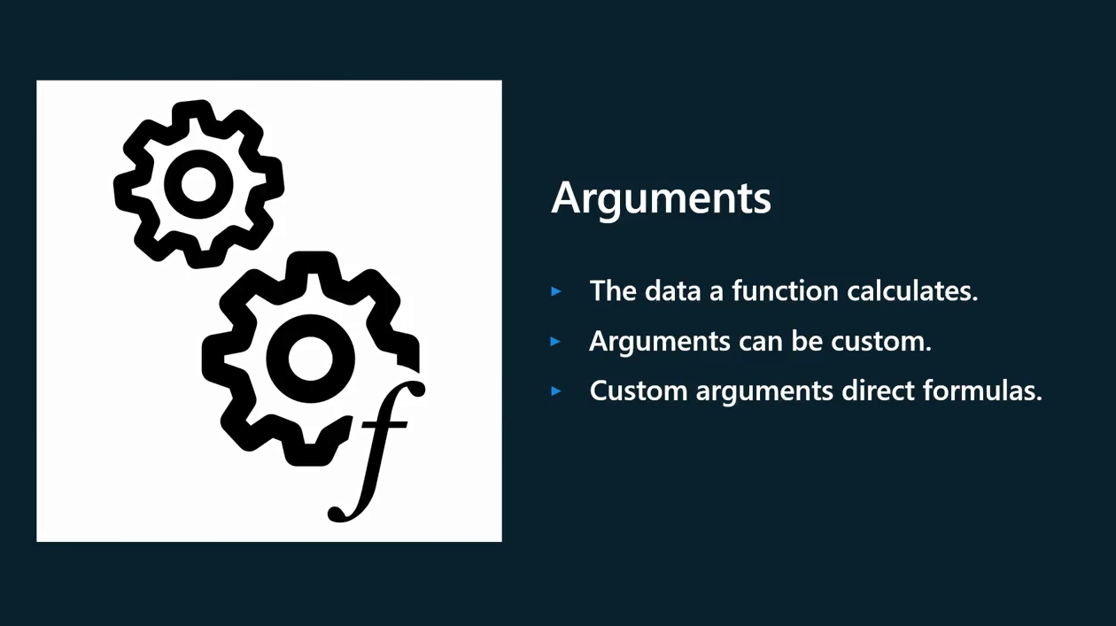

Slide 10
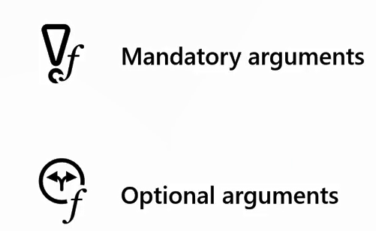
Arguments

Slide 11
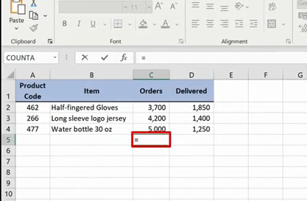
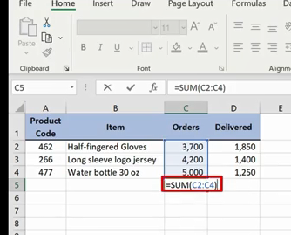
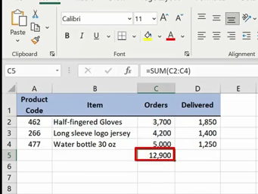
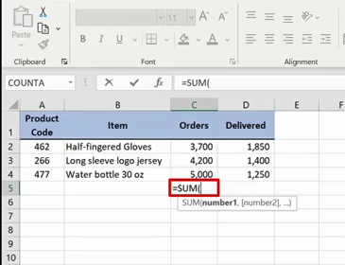
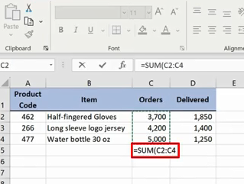
Construct a function formula

Slide 12

Demo 4 A
Using Functions

Slide 13

Question 4-1
You need to access the full range of functions available in Excel. Which ribbon do you need to select to access the full library of functions?
The Formula ribbon.
The Data ribbon.
The Home ribbon.

Slide 14

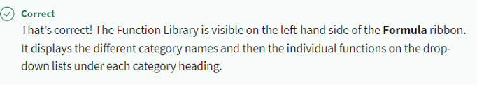
Question 4-1
You need to access the full range of functions available in Excel. Which ribbon do you need to select to access the full library of functions?
The Formula ribbon.
The Data ribbon.
The Home ribbon.
Explanation

Slide 15
3
Using The Insert Function

Slide 16

Demo 4 B

Slide 17
Question 4-2
You need to access the Insert function feature to create a function formula. What actions can you take to access this feature? Select all that apply:
Use the Insert function choice on the Formulas ribbon.
Use the FX symbol to the left of the Formula bar.
Use the Name box beside the Formula bar.

Slide 18
Question 4-2
You need to access the Insert function feature to create a function formula. What actions can you take to access this feature? Select all that apply:
Use the Insert function choice on the Formulas ribbon.
Use the FX symbol to the left of the Formula bar.
Use the Name box beside the Formula bar.

Slide 19
4
The Autosum shortcut

Slide 20
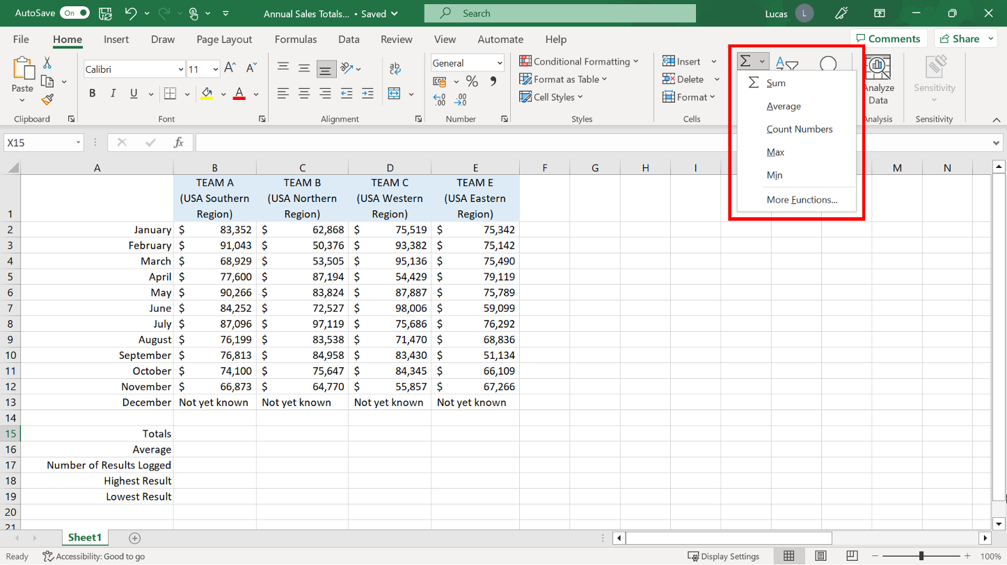
The Autosum shortcut

Slide 21
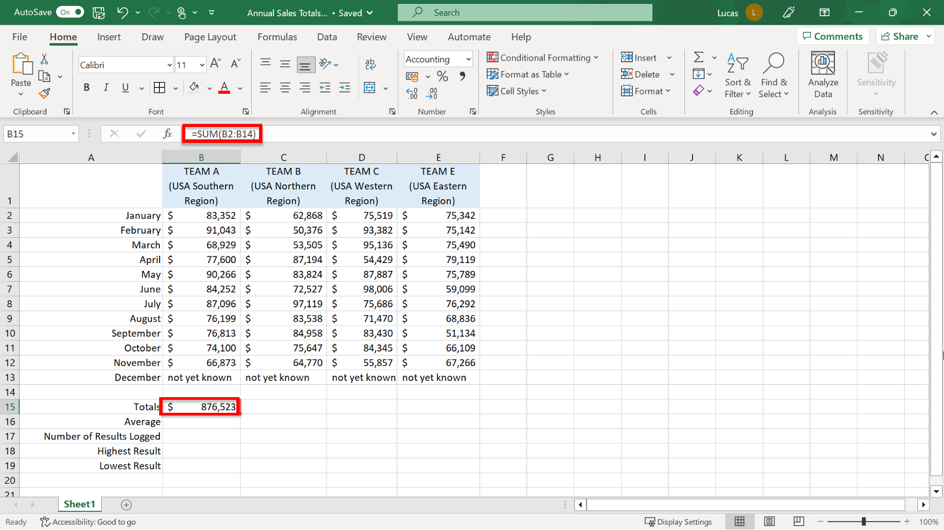
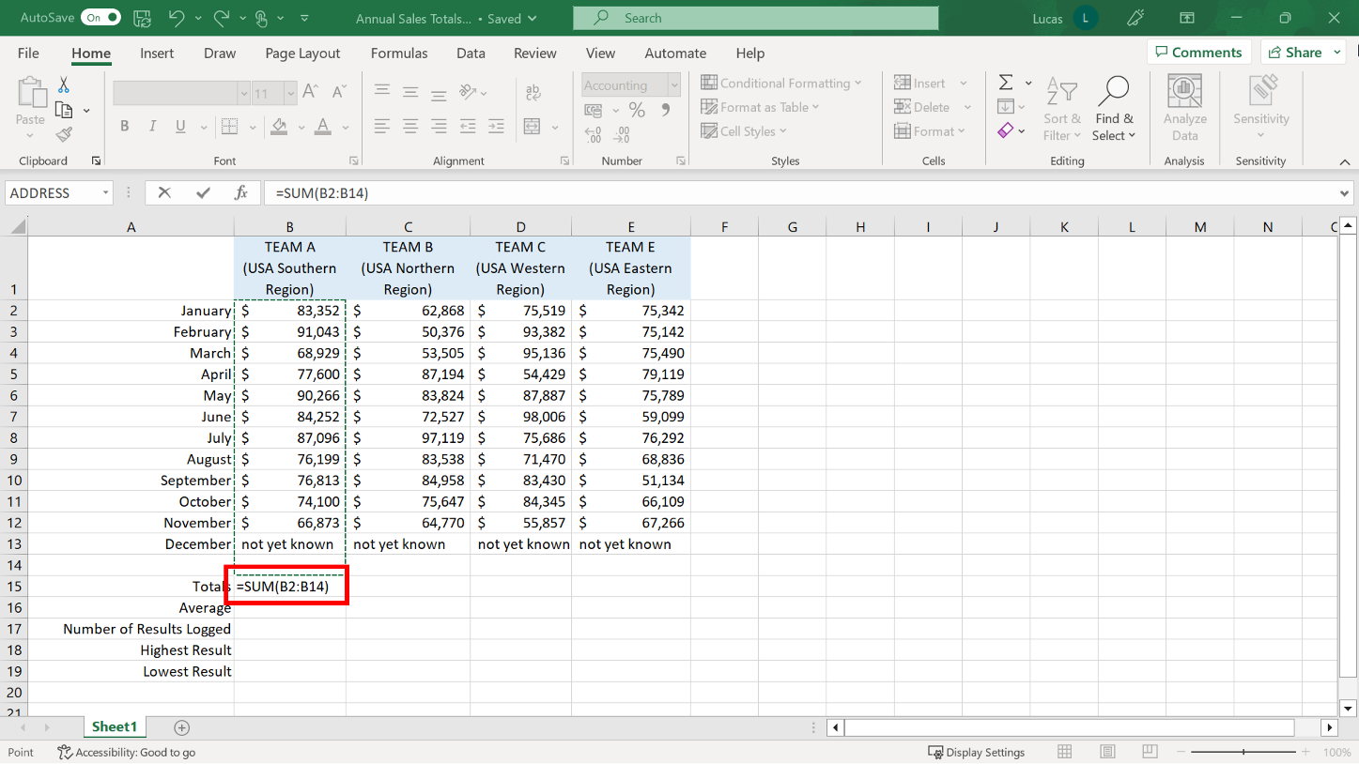
The SUM Function

Slide 22

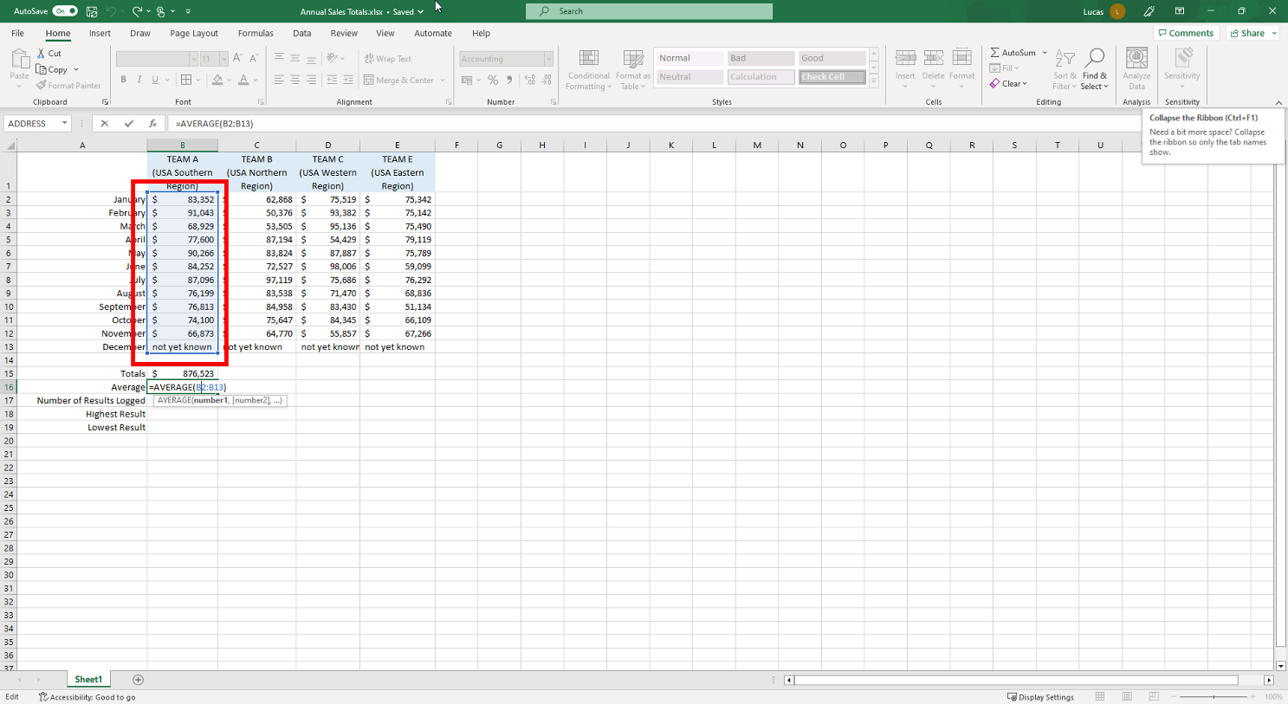
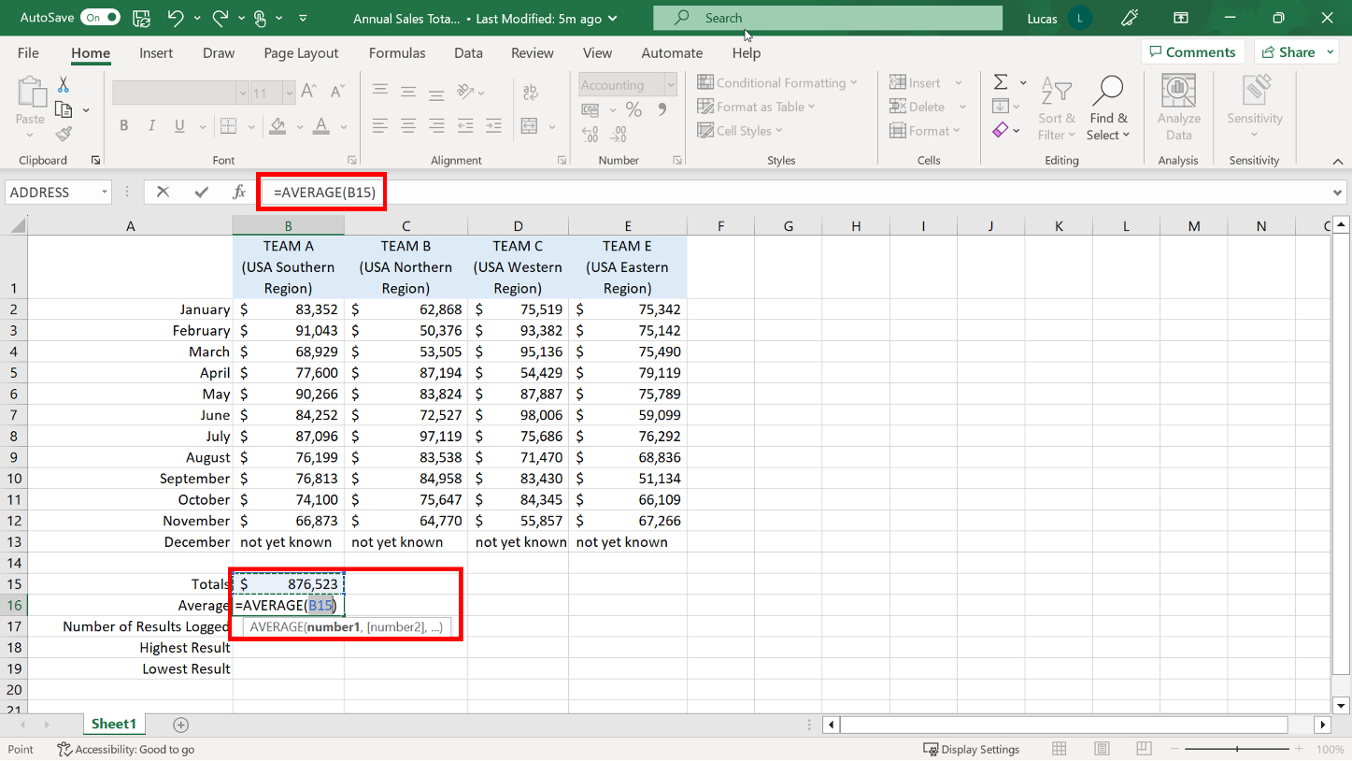
The AVERAGE Function

Slide 23
The COUNT NUMBERS function
There are three versions of the basic count function:
COUNT: This version only includes a cell in the result if it contains a numeric value.
COUNTA: Includes a cell in the count if it contains any type of content, either text or numeric.
COUNTBLANK: Reviews the cell range listed in the arguments and returns the number of cells in the range that are empty.

Slide 24
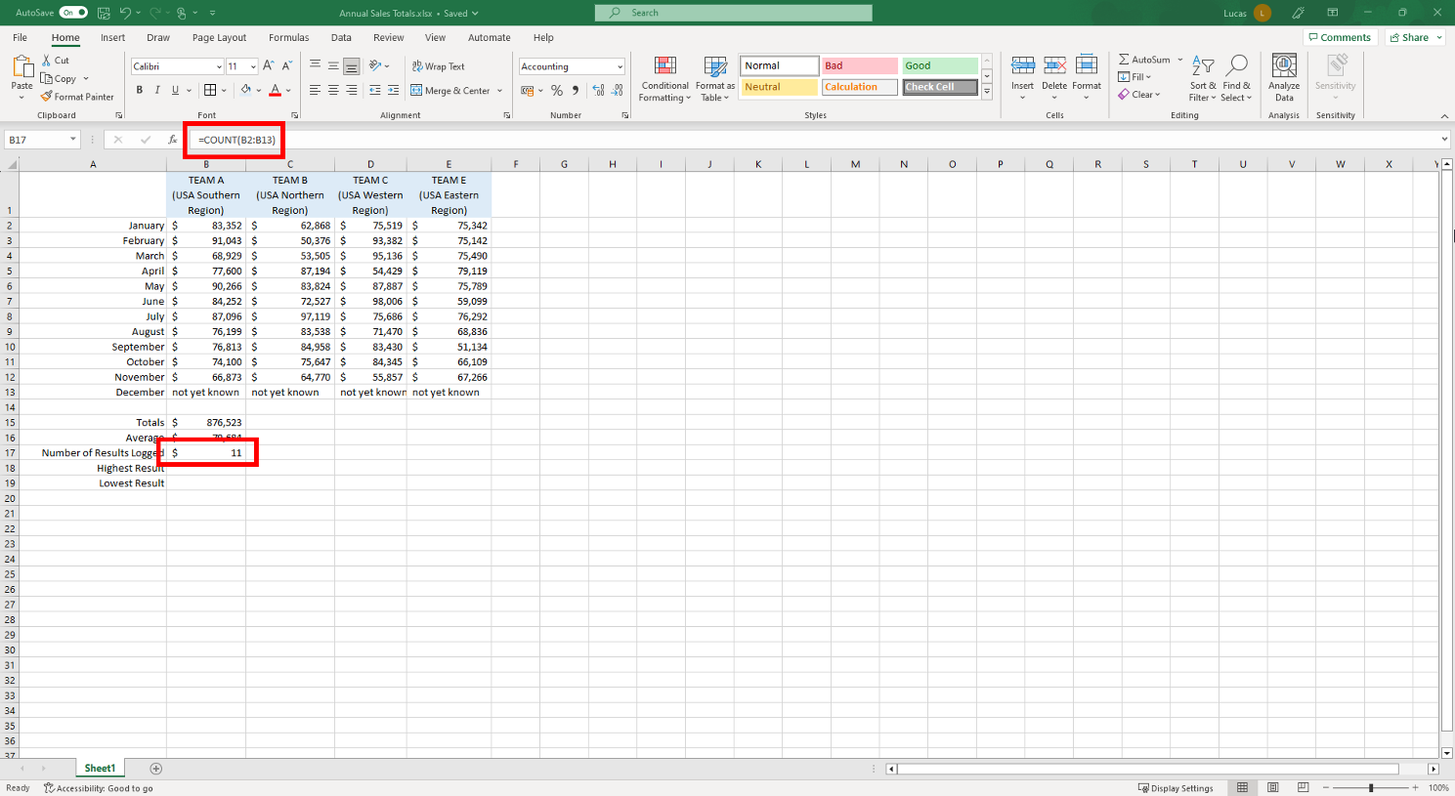
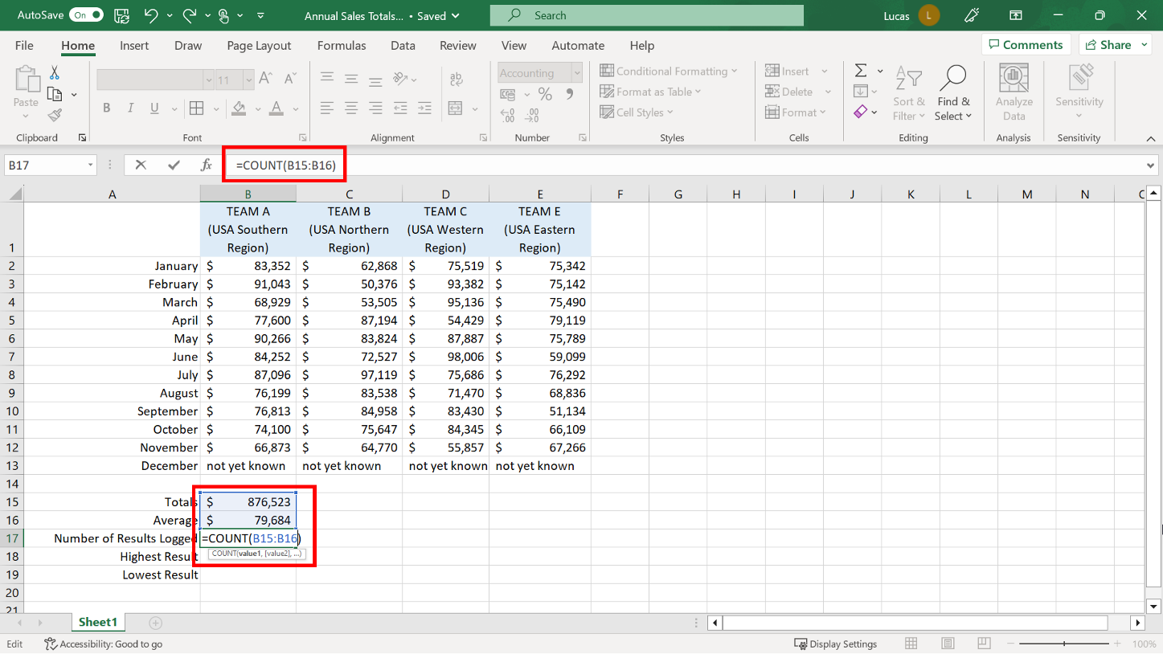
The COUNT NUMBERS function

Slide 25
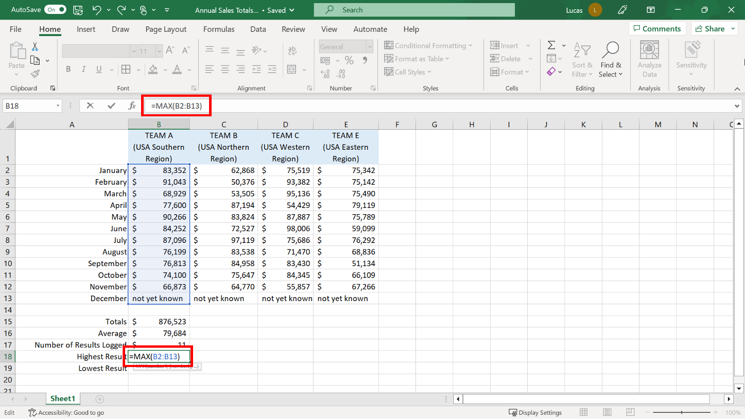
The MAX and MIN Functions

Slide 26
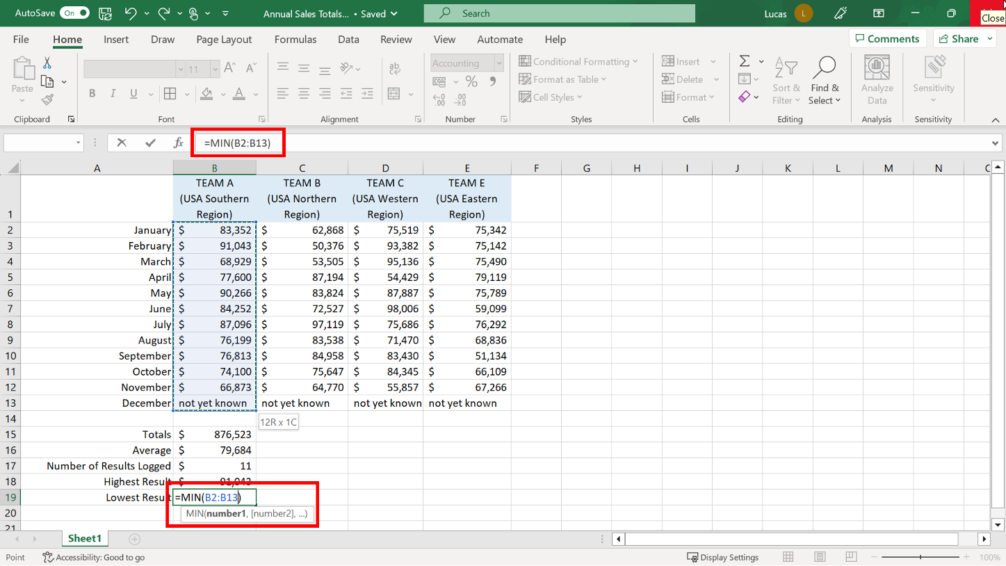
The MAX and MIN Functions

Slide 27
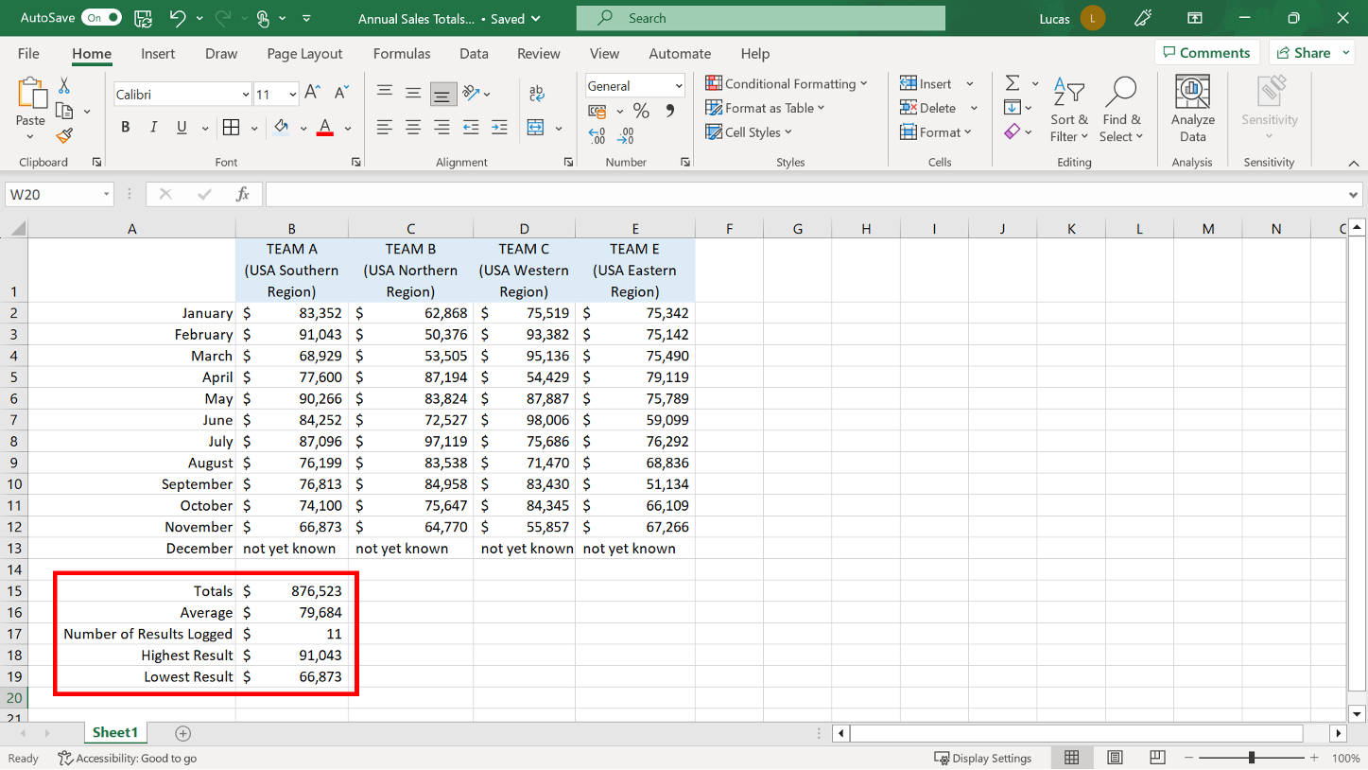

Slide 28
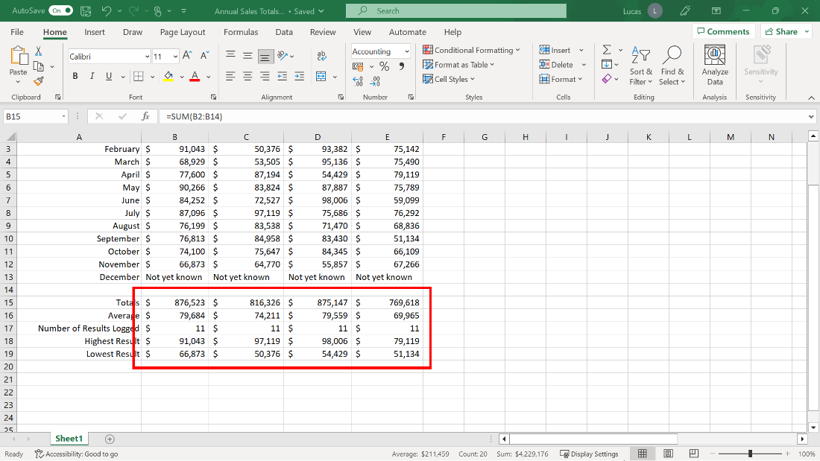
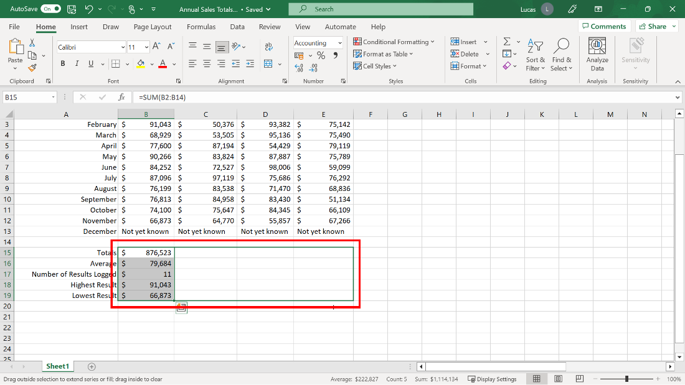
The AUTOFILL feature

Slide 29

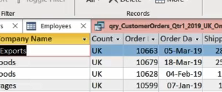
Exercise 4: Preparing a monthly sale report.

Slide 30

Exercise Questions
Question 1
Cell C34 in your worksheet is blank and cell C35 contains a formula. The cursor is on C36. If you use the AutoSum shortcut to add a SUM formula, which cell range does Excel automatically suggest as the argument for the function?
C35
C34
C36

Slide 31
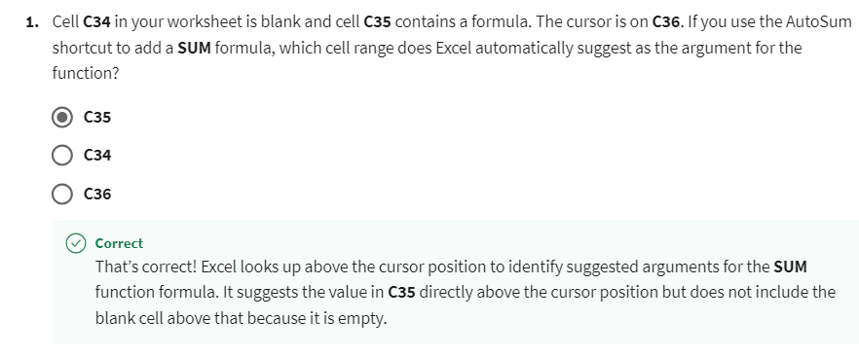
Exercise Questions
Explanation

Slide 32
Exercise Questions
Question 2
True or False: When you created the Total Revenue formula in C35, the results appeared as dollar amounts because the Accounting format had been applied to the cell in advance.
True
False

Slide 33
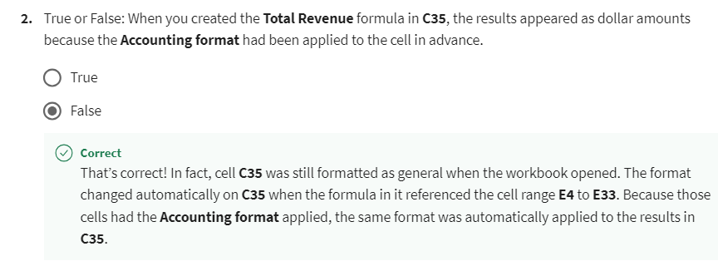
Exercise Questions
Explanation

Slide 34
Exercise Questions
Question 3
When you created the formula in C39 to count how many days there were in the month, what answer did the formula produce?
0
31
30

Slide 35
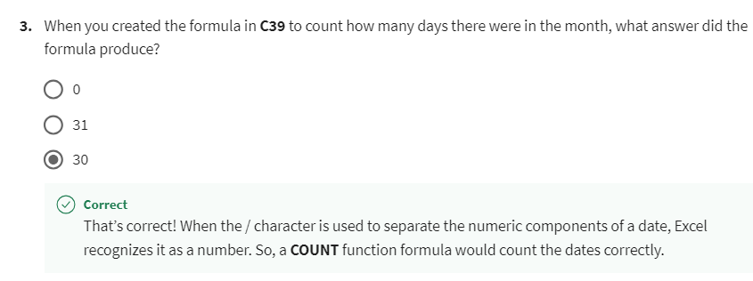
Exercise Questions
Explanation

Slide 36


Slide 37

4
Question 1
Which of the following items are part of a function formula? Select all that apply:
Parentheses
An equals sign
The function name
Periods

Slide 38
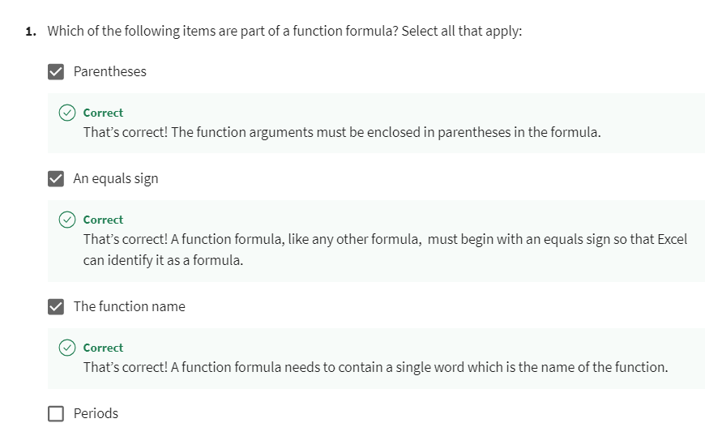
4

Slide 39
4
Question 2
You need to know how many cells in a cell range contain entries. The cells with entries contain a mixture of text and numeric entries. Which function should you use in this situation?
COUNT
COUNTBLANK
COUNTA

Slide 40
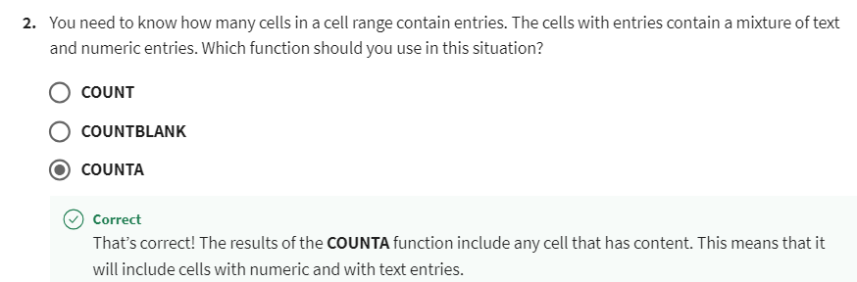
4
Explanation

Slide 41
4
Question 3
Three cells in your worksheet contain numbers. Cell D7 holds the number 10, D8 contains the number 20, and D9 contains the number 30. What is the result of the following formula when added to cell D10?
=MAX(D7:D8)
30
20
10

Slide 42
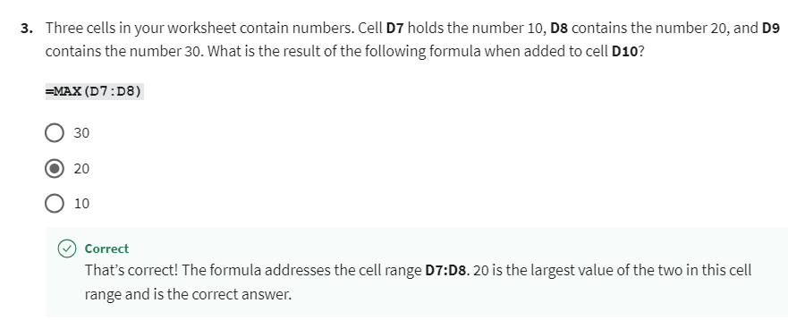
4
Explanation

Slide 43
4
Question 4
Cells B1 to B3 in your worksheet contain numbers. Cell B4 has a piece of text. You add an AVERAGE function formula to cell B5, which works out the average of cells B1 to B4. How will Excel work out the average?
Total the numbers in B1 to B3 and divide by 5.
Total the numbers in B1 to B3 and divide by 3.
Total the numbers in B1 to B3 and divide by 4.

Slide 44
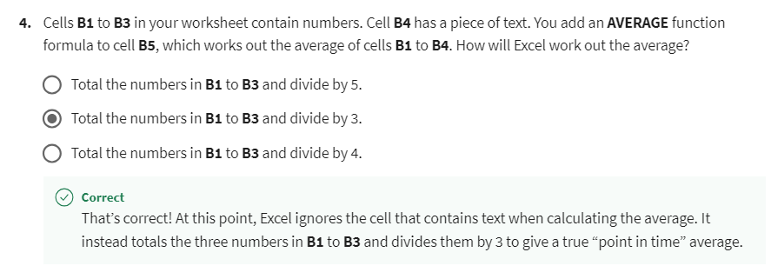
4
Explanation

Slide 45
4
Question 5
Cell E4 in your worksheet contains the value 300, cell E5 the value 300, and cell E6 the value 0. What is the correct answer to the following formula when added to your worksheet?
=AVERAGE(E4:E6)
100
200
300

Slide 46
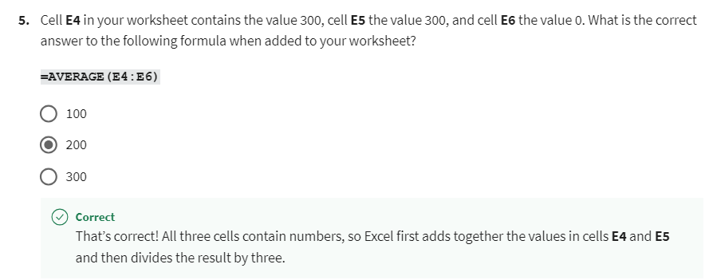
4
Explanation

Slide 47


